Slide 1



Biodiversity Capacity Building in Malaysia using Information Technology
Mohd Shahir Shamsir
Suzanna Noor Azmy
Nurul Shakina Mohd Talkah
Iylia binti Zulkifli
Teong Han Chew
Parveen Bal
Bioinformatics Research Group (birg),
Universiti Teknologi Malaysia (UTM),
Malaysia

Slide 2
Content
Team
Research highlights
Biodiversity Capacity Building in Malaysia using Information Technology

Slide 3
Team
Dr Mohd Shahir Shamsir bin Omar (Supervisor)
Chew Teong Han (Research Officer)
Farizuwana Akma binti Zulkifle (Master Student)
Nurul Shakina bt Mohd Talkah (Master Student)
Lau Cher Chien (Master Student)
Leong Geok Wei (Master Student)
Lee Sheau Chen (Master Student)
Muhammad Nor Akmal bin Ismail (Master Student)
Hamed Bostan (Research Assistant)
Tan Kwee Hong (Research Assistant)
Suzanna Noor Azmy (Master Student)

Slide 4
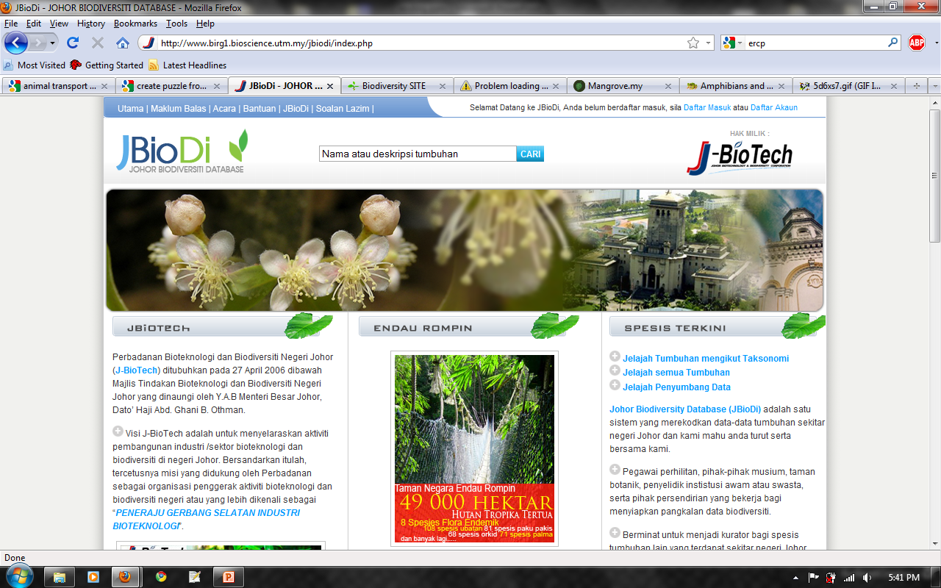
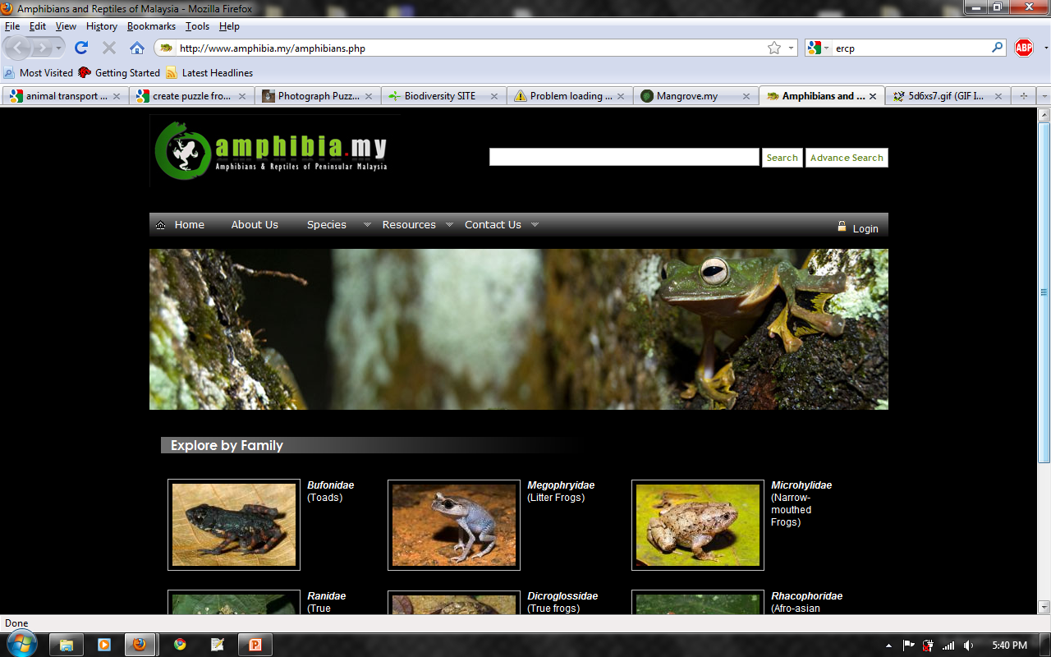
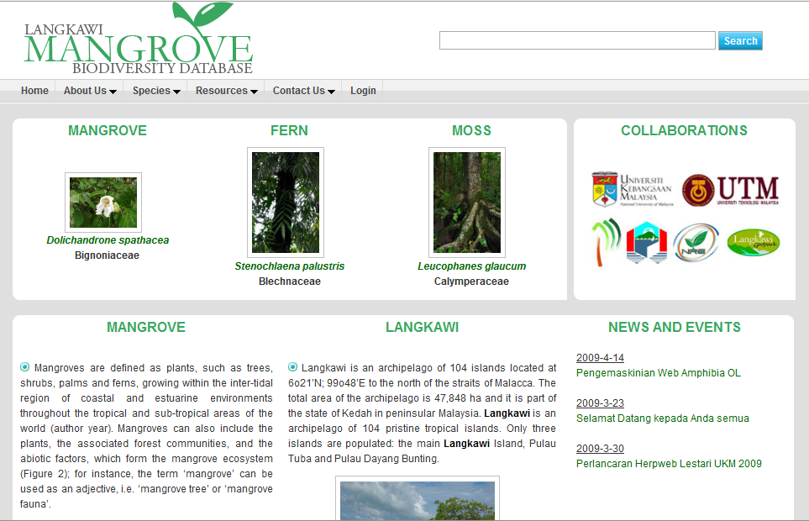
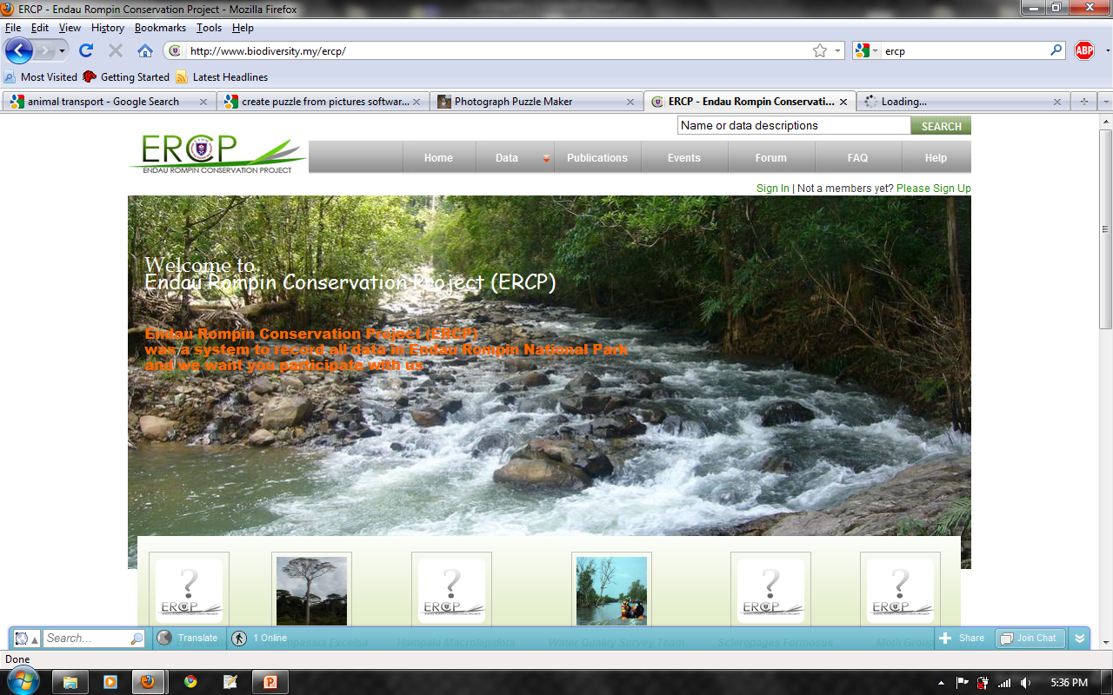
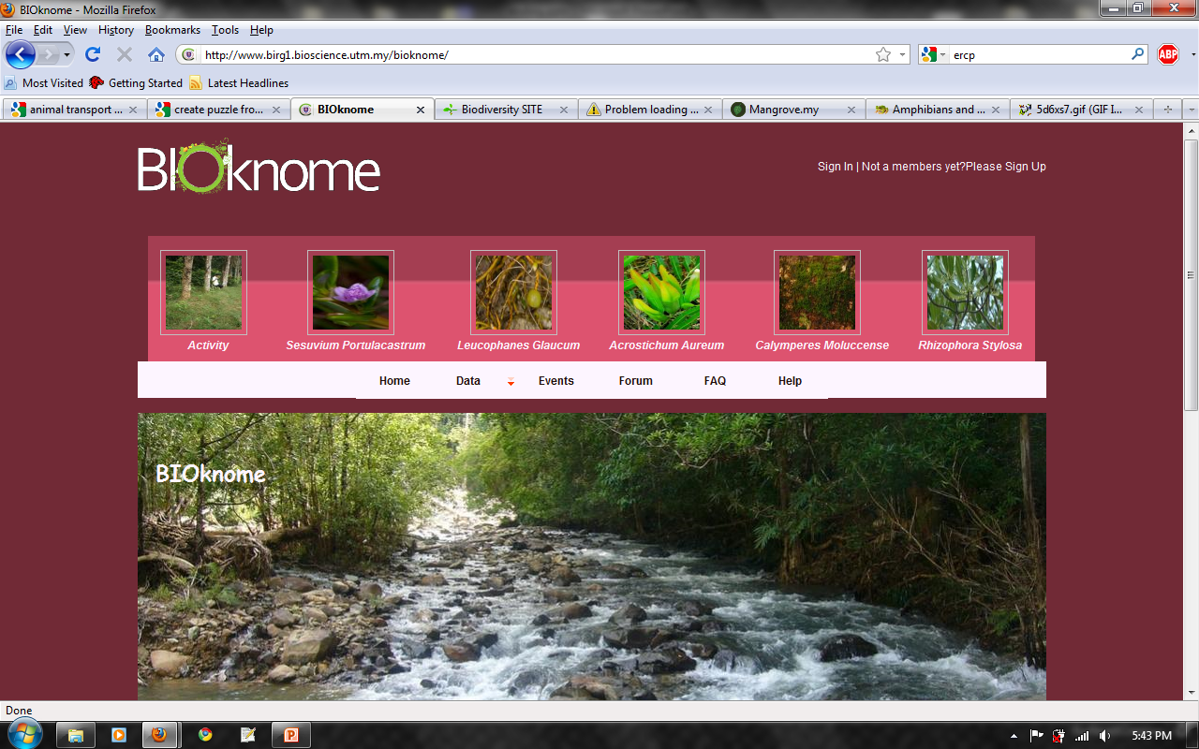
Biodiversity Databases

Slide 5
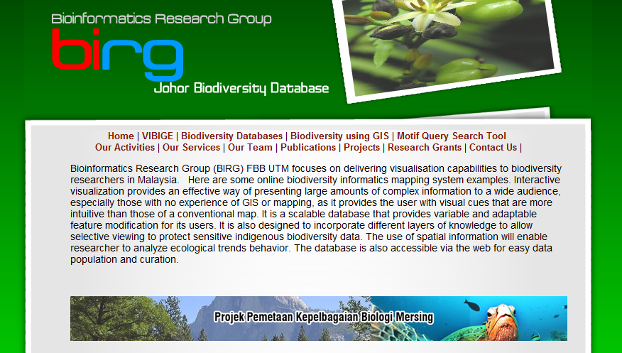
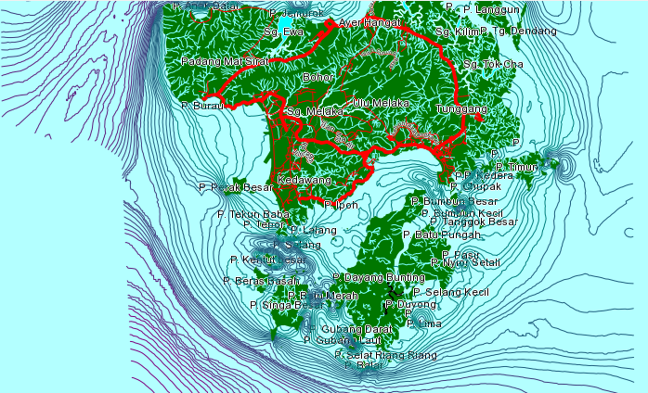
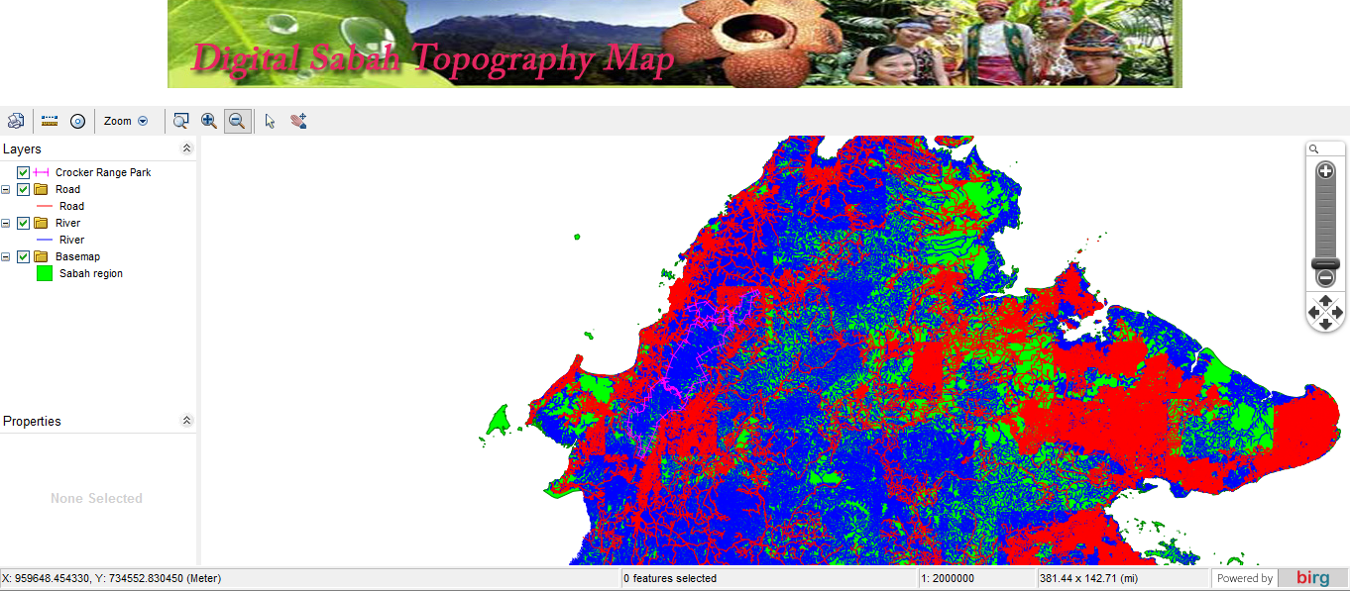
GIS Mapping
DATA COLLECTION
MAPPING
ANALYSIS
WEB BASED APPLICATION

Slide 6
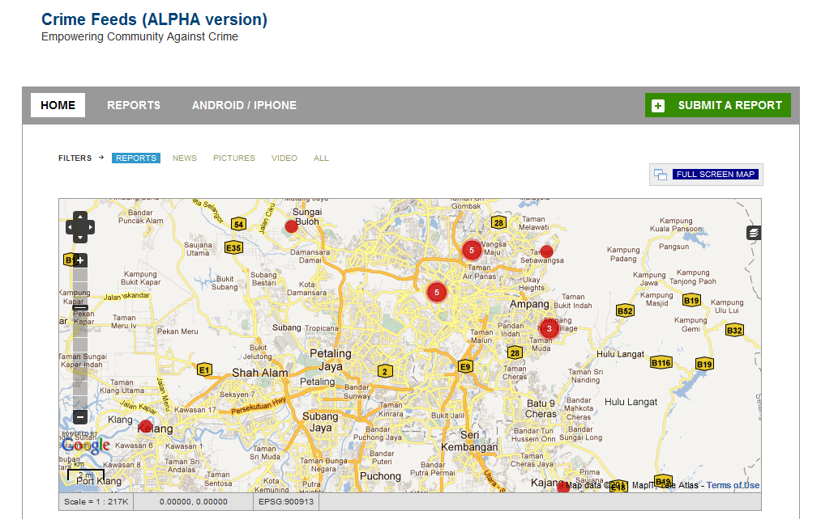
Mapping & Mobile Reporting

Slide 7
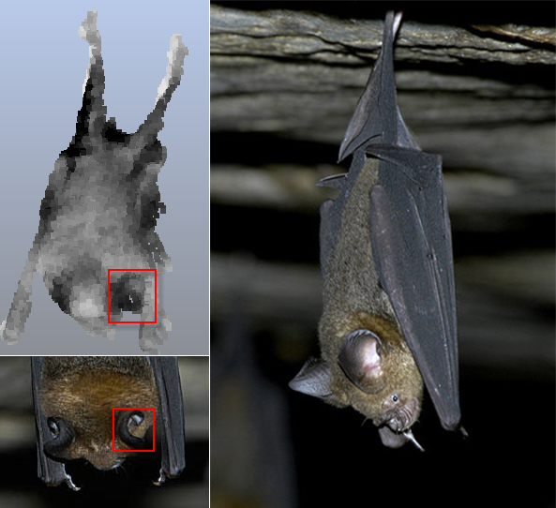
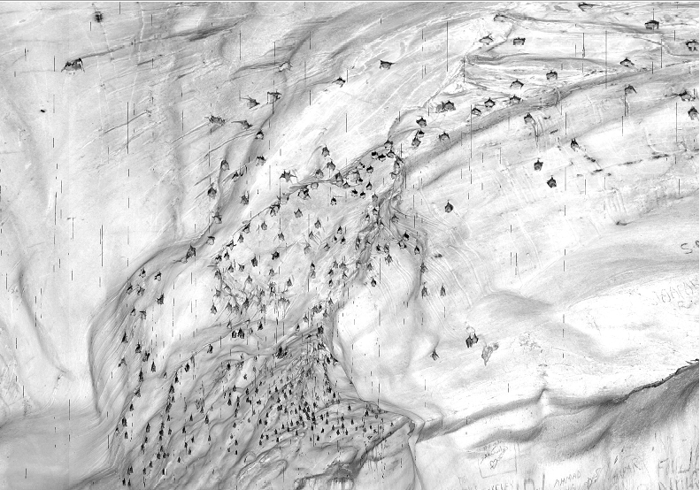
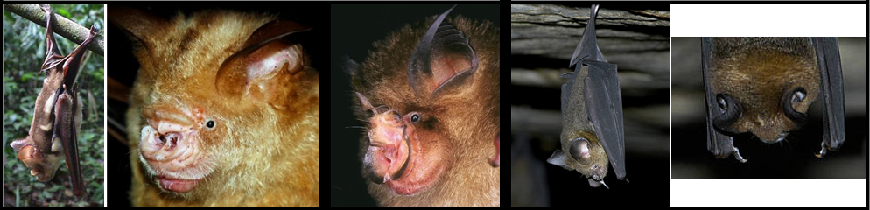
Laser Scanning
SPELEOLOGICAL SURVEY
SPECIES IDENTIFICATION

Slide 8
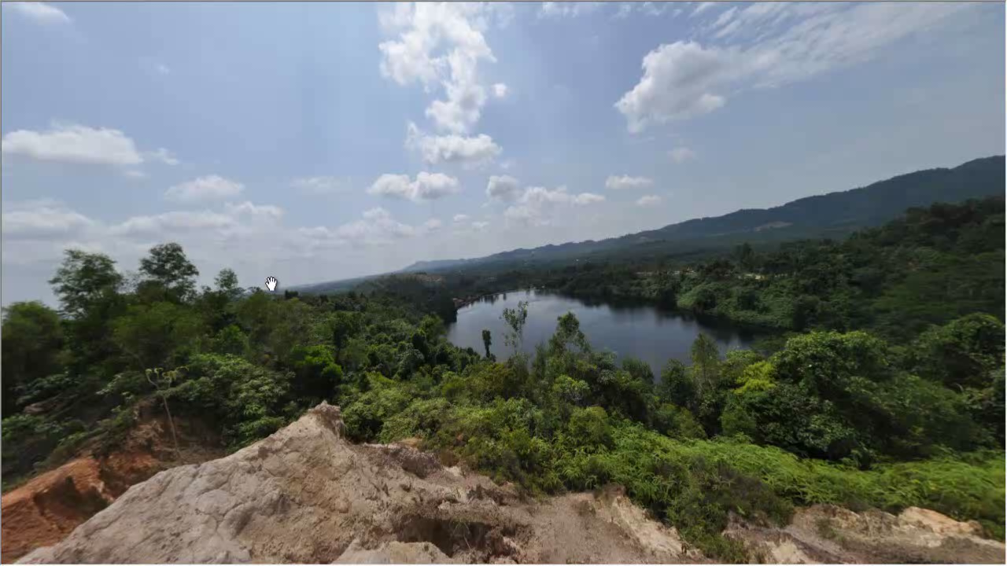
360 Panoramic Biodiversity Observation

Slide 9
Introduction
Biodiversity data issues
Mismanagement
Legacy, flat files
Data sharing
Malaysia
Mega diversity but data available not significant
Our efforts
Biodiversity informatics and support

Slide 10
Our Efforts
Knowledge discovery
Information management
Information sharing
Information outreach

Slide 11
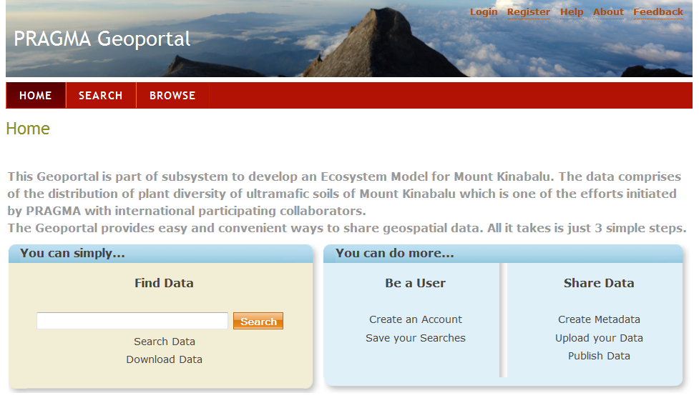
Knowledge Discovery
Geoportal
Member of PRAGMA biodiversity team
Metadata host for Mt Kinabalu flora
Part of pragma grid for ultramafic environment studies

Slide 12
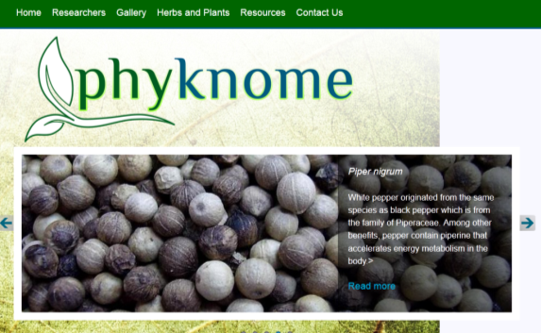
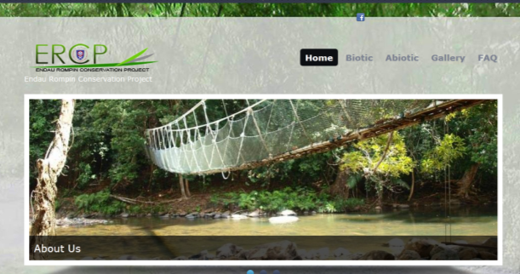
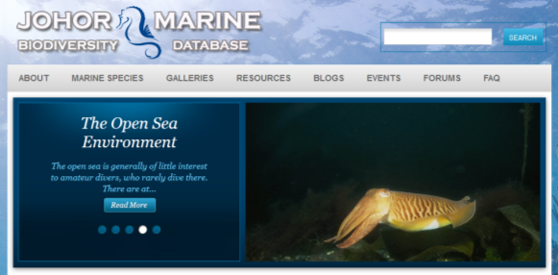
Information Management
Phyknome
Ethnobotanical & Phytochemical Knowledge DB
20,000 species of Malaysian plants
http://mapping.fbb.utm.my/phyknome
Others
ERCP: M’sia national park DB
JMarine: Johor marine DB

Slide 13




Information Sharing
GBIF
1st and only node in M’sia (thanks ACB)
6 datasets
Amphibians
Reptiles
Moss
Fern
Mangrove
http://birg4.fbb.utm.my:8080/ipt

Slide 14



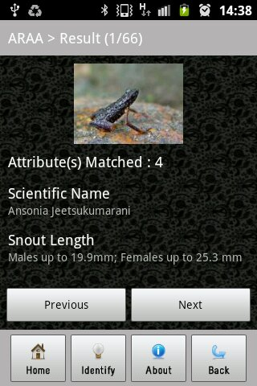
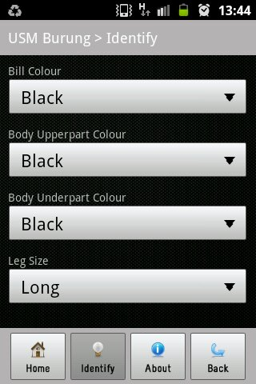
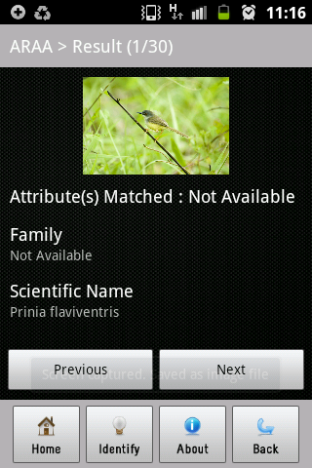
Information Outreach
Mobile app
Species identification
Amphibian
Birds

Slide 15
Thank You

